Slide 1
Salivary glands

Slide 2
Functions of saliva

Slide 3
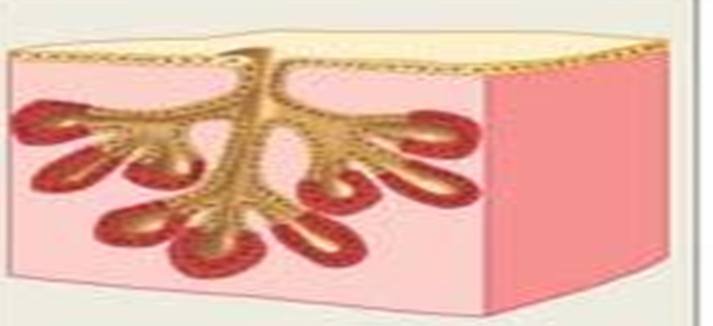
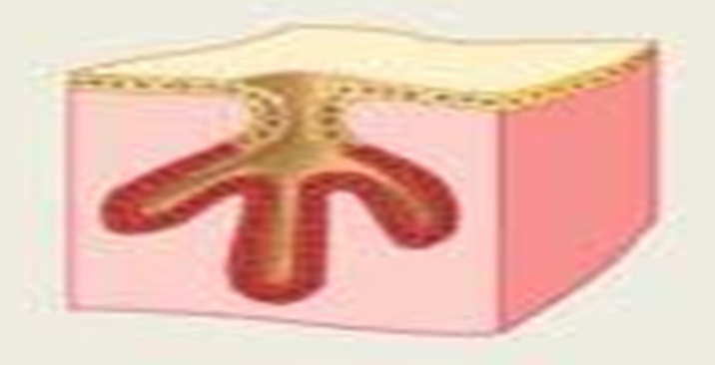
Salivary glands
Salivary glands are two groups:
1- The major salivary glands:
Parotids, sublingual and submandibular glands.
They are compound tubuloalveolar glands.
Their secretion is regulated by nervous reflexes.
2- The minor salivary glands:
The buccal, labial, lingual&palatine glands.
They are simple branched tubuloalveolar glands.
They secrete continuously to moisten and lubricate the oral cavity.

Slide 4
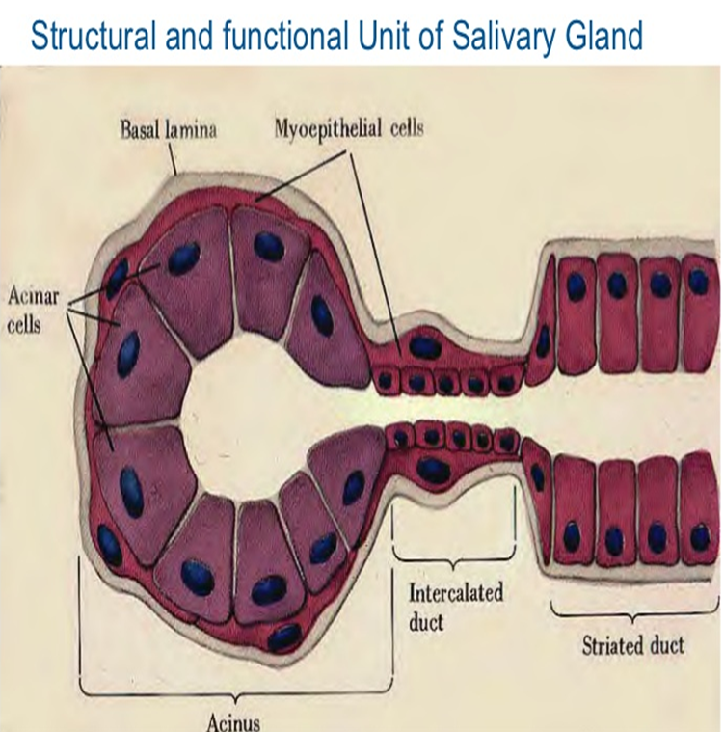
Structure of the major salivary glands

Slide 5
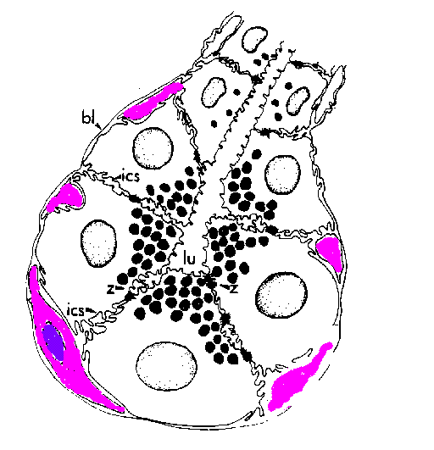
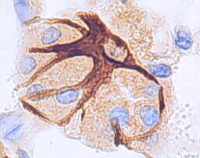
Myoepithelial cells=basket cells
Shape: stellate cells with many processes containing actin & myosin.
Site: around the acini especially mucous one & along the proximal portions of the ducts.
Function: They contract to squeeze the secretion from the acini into the lumen of their ducts.

Slide 6
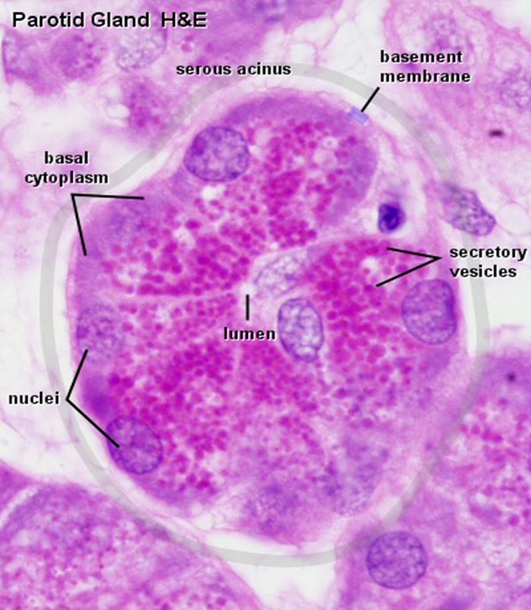
1- Serous acini
Secretion: watery, rich in salts and digestive enzymes.
Sites: in the parotid, submandibular and the Von Ebner’s glands.
Structure:
Shape: small, rounded with a narrow lumen & darkly stained.
Lining cells: pyramidal.
Nucleus: rounded & situated nearer to the base .
Cytoplasm: basal basophilic cytoplasm (rich in rER) with apical acidophilic secretory granules (zymogen granules).
Myoepithelial cells: few basket cells surround the acini ( because their secretion is watery and flow easily).

Slide 7
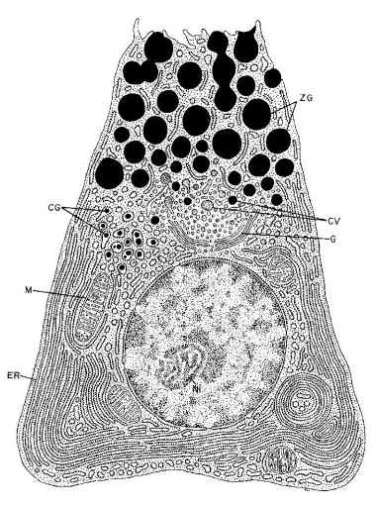
How the serous acinus adapt to its function?
EM: protein secreting cells.
1- Basally: rER.
2- Supranuclear Golgi.
3-Apically: secretory granules.

Slide 8
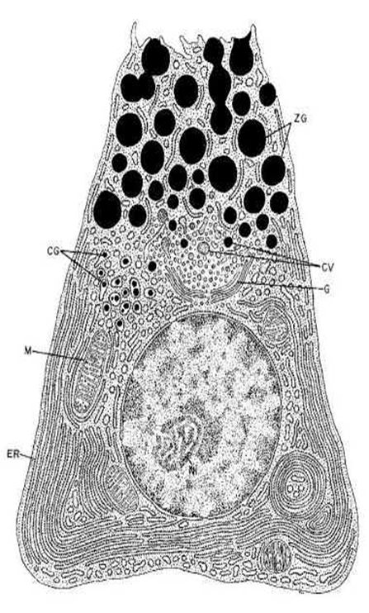
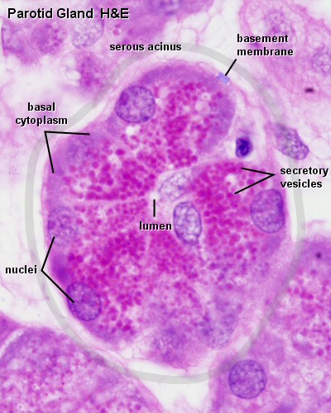
1- Nucleus near to the base: pushed by apical secretory granules.
2- Basal basophilia: numerous rER.
3- Apical acidophilia: secretory granules.

Slide 9
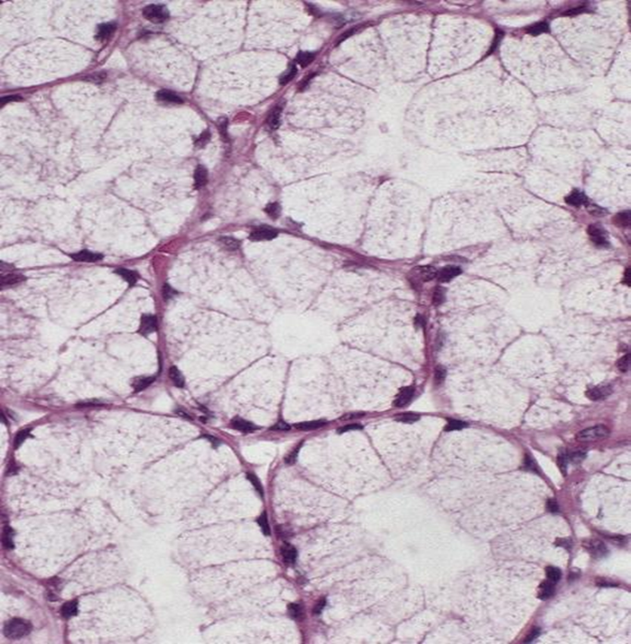
2-Mucous acini
EM: glycoprotein secreting cells

Slide 11
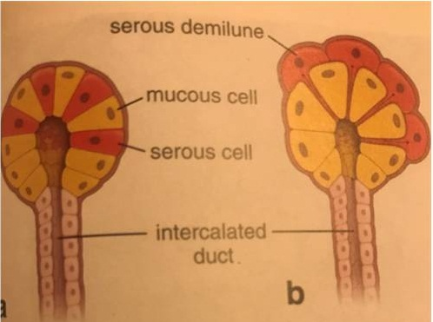
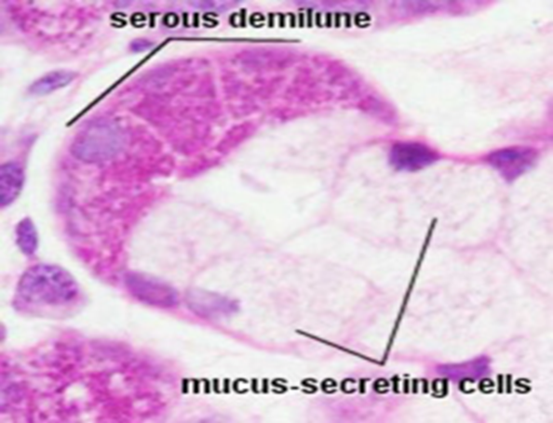
3-Mixed (seromucous) acini

Slide 12
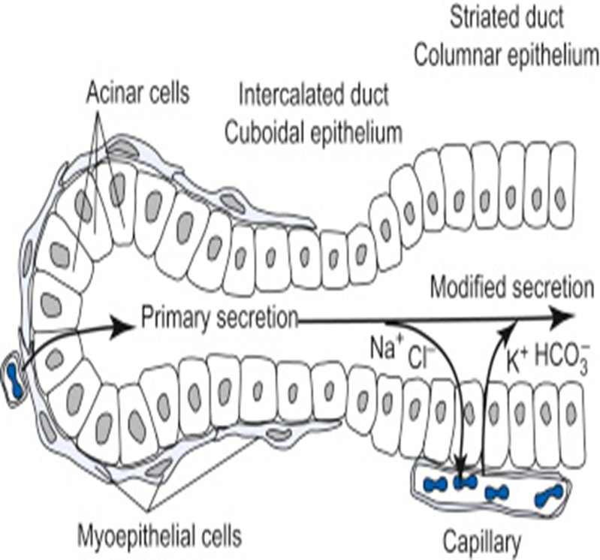
1- The intralobular ducts: consists of 2 parts:
A- The intercalated ducts: drain the secretory acinus& lined by low cuboidal cells.
B- The secretory striated ducts:
Shape: They have a wide lumen.
Lining cells: cuboidal.
Nucleus: central& rounded.
Cytoplasm: acidophilic (numerous mitochondria) with basal striations (basal infoldings).
Function: They modify the composition of saliva by active ion pump making the saliva hypotonic solution.

Slide 13
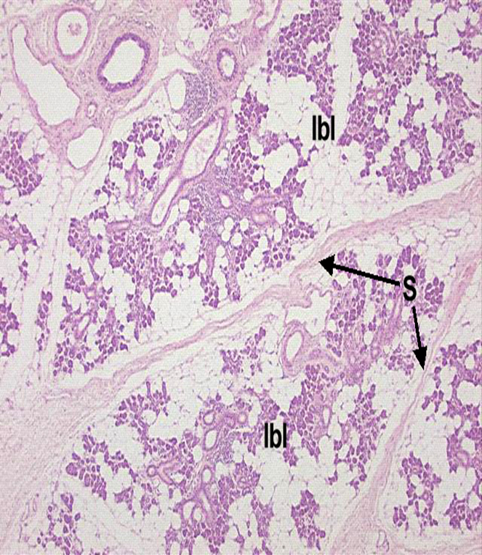

Slide 14
A-The parotid gland
Capsule &septa: thick.
Fat cells: large number.
Secretory acini: 100 % serous acini.
Myoepithelial cells: few.
The intralobular ducts: long, secretory striated ducts form 50% of the length of the intralobular duct.

Slide 15
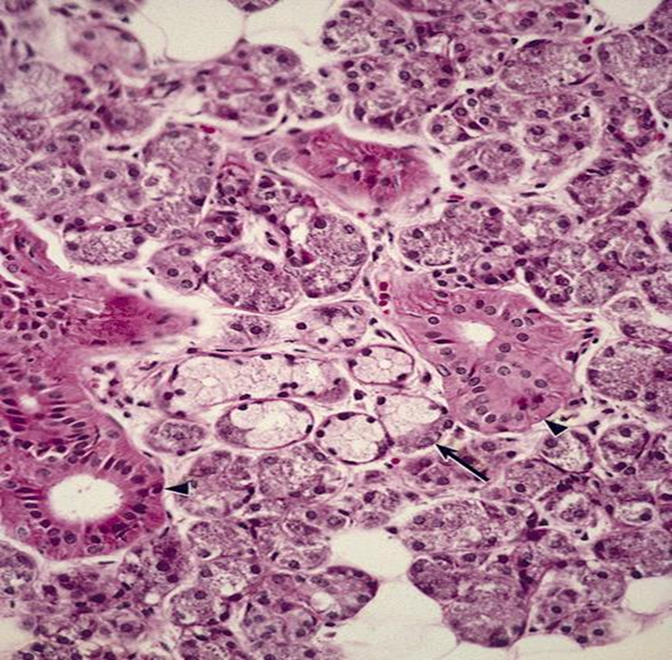
Capsule &septa: moderately thick.
Fat cells: less numerous.
Secretory acini: 80% serous acini, 20% mucous acini.
Myoepithelial cells: frequent.
The intralobular ducts: moderately long, secretory striated ducts form 80% of the length of the intralobular duct.

Slide 16
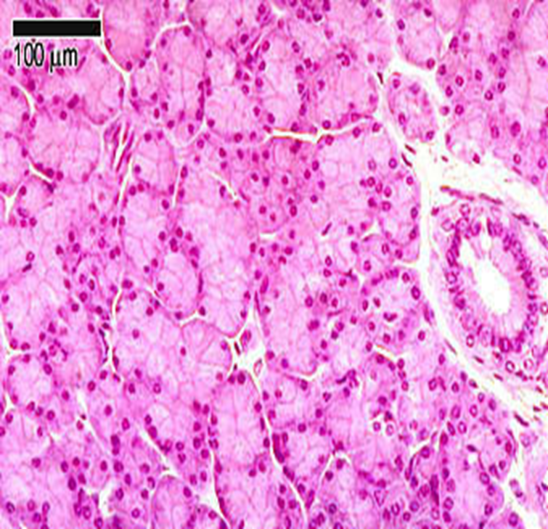
Capsule &septa: thin capsule, relatively thick septa.
Fat cells: absent.
Secretory acini: 99% mucous, 1% serous, represented by the serous demilunes.
Myoepithelial cells: numerous.
The intralobular ducts: very short, secretory striated ducts form 99% of the length of the intralobular duct.

Slide 18
THANKS

